Slide 1
Socioeconomic & Political Influences on Suicide Rates

Slide 2
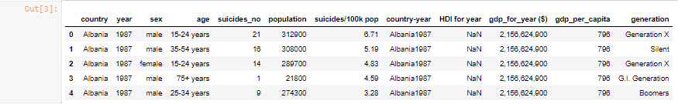
HYPOTHESES
How do different socioeconomic and political factors within a country affect suicides rates (per capita)?
Do different levels of military interference, GDP per capita, or even geographic latitude show a correlation with suicides rates? Are suicide rates higher for some generational groups than others?

Slide 3
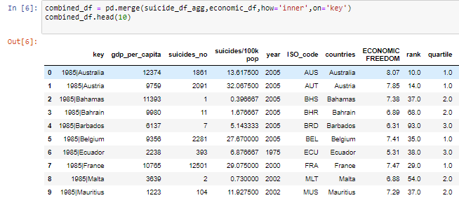
We parsed Kaggle for data sets and found one featuring suicide rates by country and year and another data set, also by country and year, with varying socioeconomic and political “scores”, a rank, and some other indicators. We combined the datasets in pandas using a merge on a concatenated key common between both sets and then began asking questions about the impact of these socioeconomic factors on suicide rates worldwide and then provide visual representations using matplotlib and seaborn.
METHODS

Slide 4
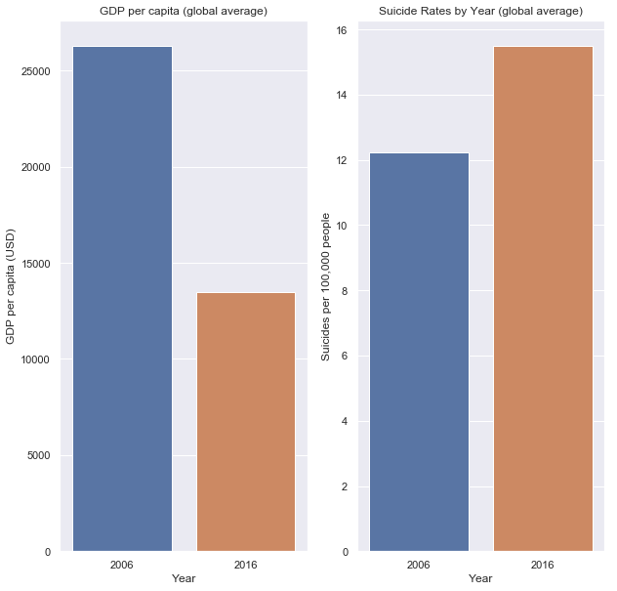
Is there a correlation between average GDP per capita globally and the average number of suicides per 100k people globally, between 2006 and 2016?

Slide 5
Between 2006 and 2016, average GDP per capita - a leading indicator of economic equity between socioeconomic classes - dropped 48% while at the same time, suicides per 100k people rose globally by 27% (on average, by country).
There does appear to be an inverse correlation and also illustrates a potential trend over time.
LIMITATIONS: testing this type of correlation with two subplots is hardly sound; a two-sample test or linear regression should be performed to test this alleged correlation’s significance.

Slide 6
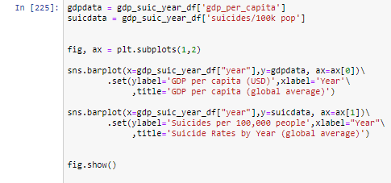

Slide 7
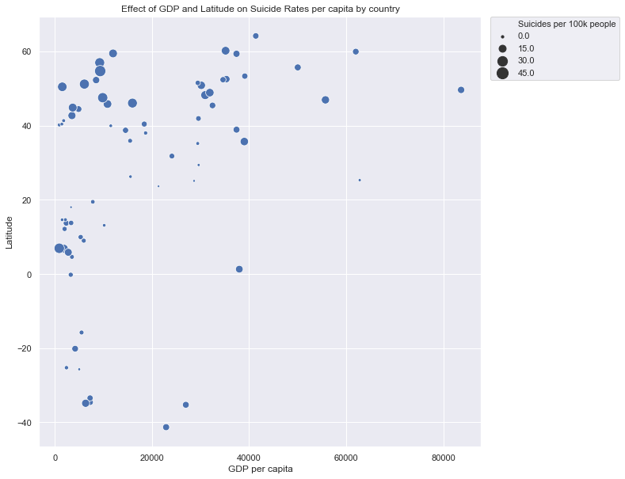
Are there any correlations between the latitude of a country, the average GDP per capita and the average suicide rate?

Slide 8
Countries at higher latitudes tend to have more suicides per 100k people. There also seems to be an interesting side correlation between GDP and latitude, with countries below the equator all having relatively low GDP per capita.
LIMITATIONS: There are many more countries surveyed above certain latitudes. Sampling exercises and a proper statistical analysis would yield a better result.

Slide 9
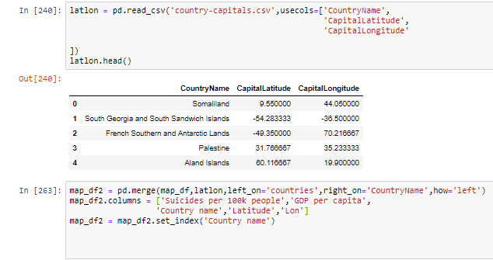

Slide 10
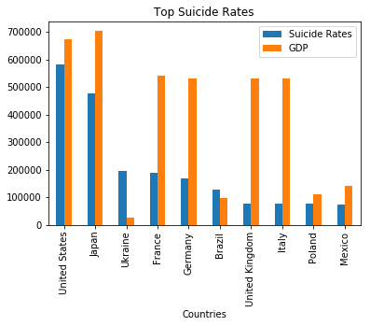
Does GDP per capita have a Correlation with Suicide Rates?

Slide 11
Analysis
The initial thought was that countries with a higher GDP per capita would have lower suicide rates. It turns out that there is actually no correlation between the two.
Limitations:
This data is only from the year 2016

Slide 12
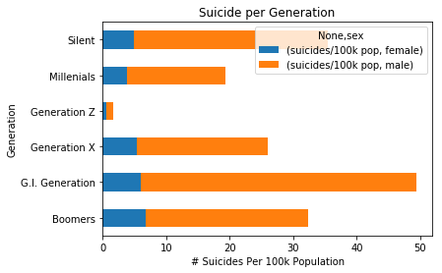
# Of Suicides Per Generation In The US

Slide 13
Analysis
In the United States it seems that the generation with the most suicides per 100k is the G.I Generation. This is the generation born between the 1900’s and the 1920’s. What was interesting was in every generation men generally had the most suicides.
Limitations:
Not all generations have the same amount of data because they haven’t lived as long

Slide 14
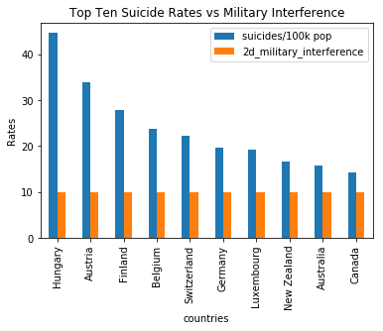
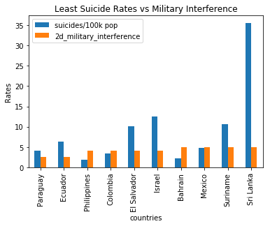
Suicide Rates vs. Military Interference

Slide 15
We found the top ten countries with the highest suicide rates and military interference as well as the smallest amount of military interference to suicide rates.
There doesn’t seem to be much of a correlation between military interference (as scored)
Any implications of that could also be latitude as well a more religious countries.

Slide 16
FIN

